Slide 1
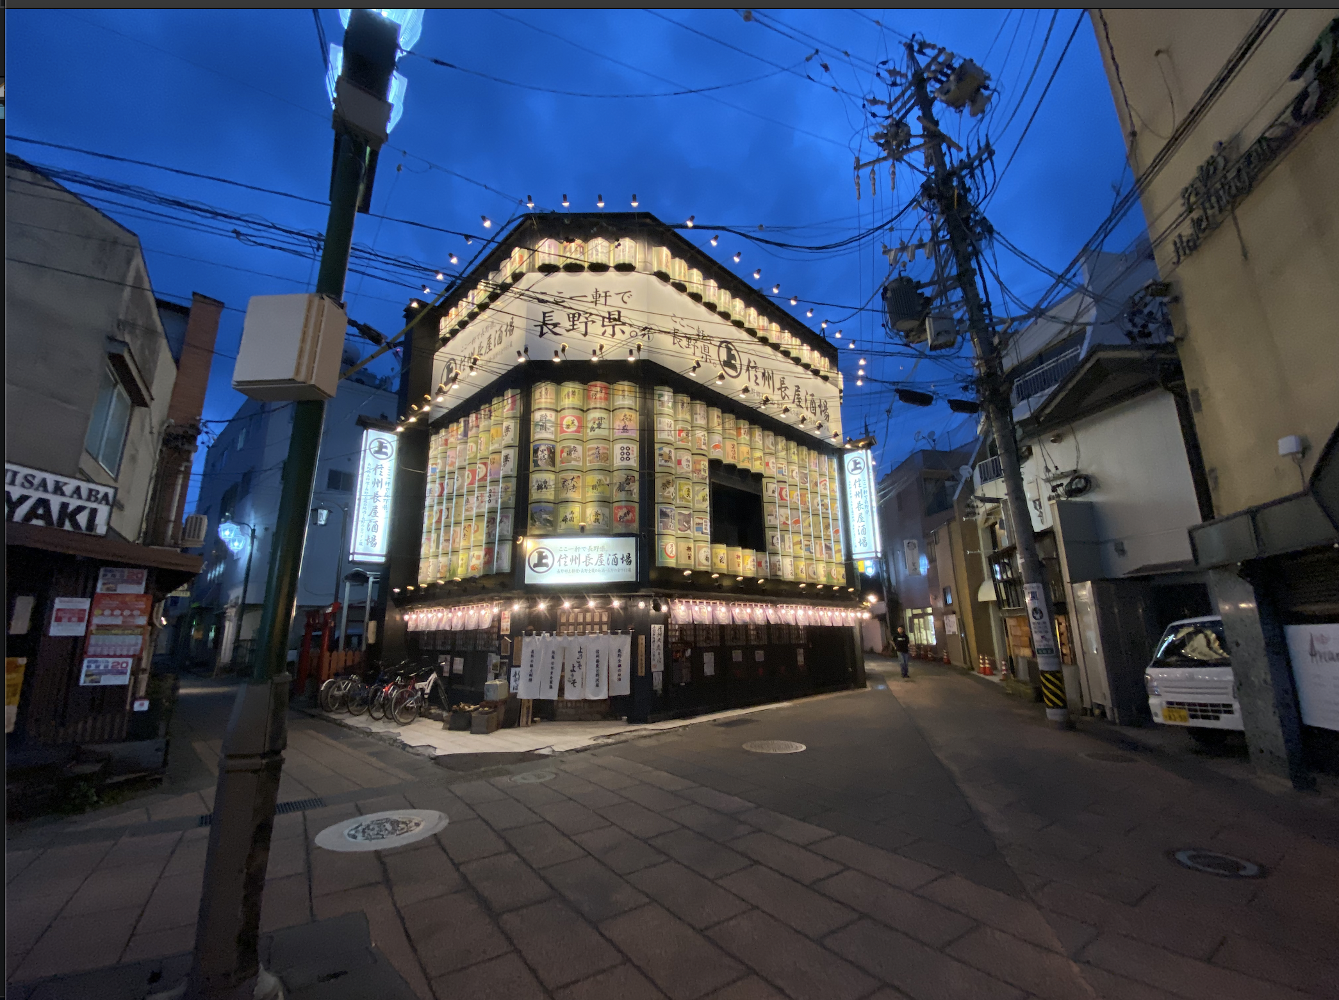
My Travel Bug
Everything you need to know about where you want to go

Slide 2
Introduction: Want to Get Away?
What to know:
Airfare schedules and costs
How far will your money go?
What to wear for the weather
What it looks like?

Slide 3
Add Airfare API query
We used an API for travelpayouts.com for current airline ticket data. The data is informative and not functionalized for purchasing tickets.
Price range, departure date, return date, class. Airline carriers not included.

Slide 4
Currency Converter
exchangerate-api.com - for currency exchange data
Works in base currency: US Dollar conversion to…

Slide 5
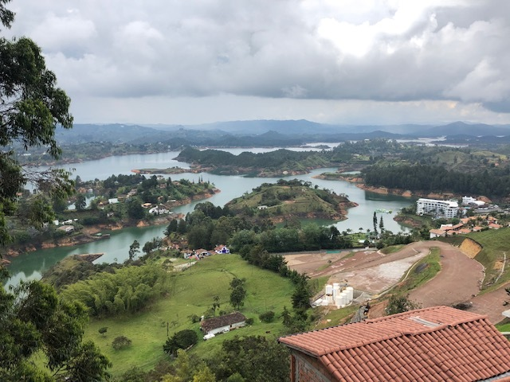
openweathermap.org API for weather forecast
Current weather
Five day forecast
UV Index

Slide 6

What does it look like where I’m going?
windy.com shows webcams of various locations from city centers, transit hubs, cityscapes, stores, parks, and other destinations

Slide 7
Challenges
Update country codes in js and html to alpha two letter code
Airline API required alpha three letter city code
Exchange currency API currency to currency conversion that was pay only
Webcam API was complicated
Project manager transferred to another class during the project, but remained involved.

Slide 8
Directions for future development
Detailed accomodation list including hotels, hostels, air bnb
News headlines for destinations
Car rental
Special events taking place
Tourist attractions
Most popular dish
MONETIZATION

Slide 9
URL: https://ionathas78.github.io/LiveTravelInfo/

